Slide 1
Lecture 7 – Public Key Encryption
Chad Mourning
Heavily from the Textbook

Slide 2
History
Proposed by Whitfield Diffie and Martin Hellman in 1976.
First documented use of asymmetric encryption
Literally requires math that didn’t exist before the middle ages, sorry Pythagoras.
Also Ralph Merkle heavily involved. Not sure why the book left him out.
Merkle Trees are really cool
May find a way to shoehorn those in later

Slide 3
Notes
Just because your encryption is asymmetric doesn’t necessarily mean it’s more secure.
In some ways, more vulnerable to cryptanalysis
Remember, our OTP XOR per bit is optimal, and symmetric.
Most encryption today starts with an asymmetric handshake and key exchange and then proceeds symmetrically
Symmetric encryption is not obsolete

Slide 4
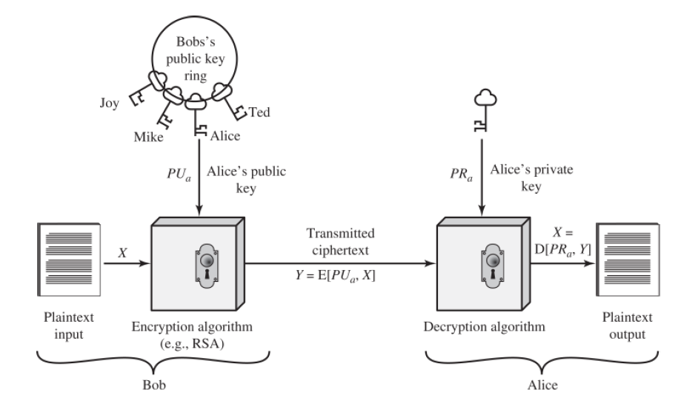
Public key first, great for confidentiality
Name conventions:
You will notice Alice and Bob a lot.
Sometimes Carol for a 3rd person.
Often Trudy as an illicit actor.
Notice RSA on here
We’ll circle back
Probably an assignment.

Slide 5
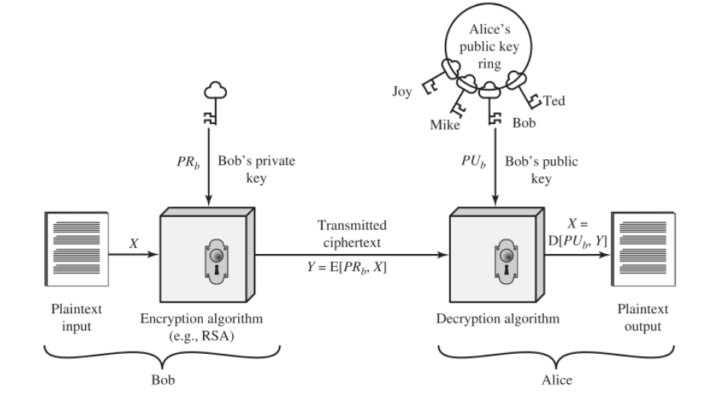
Private key first, great for authentication

Slide 6
Public Key Cryptosystems
Digital Signature
Symmetric Key Distribution
Encryption of Secret Keys

Slide 7
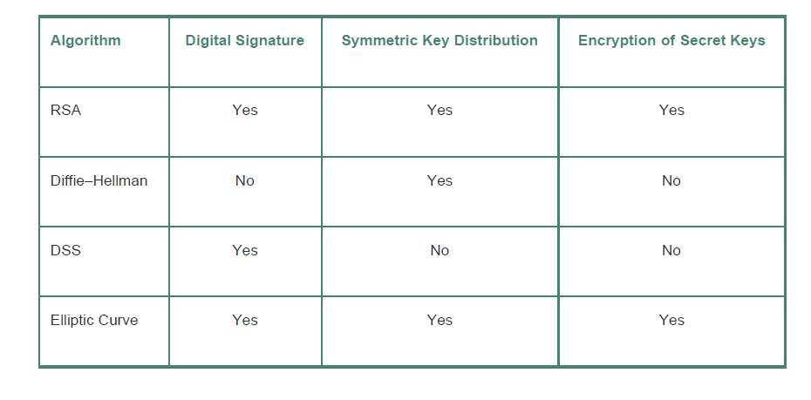
Applications for Public-Key Cryptosystems

Slide 8
Requirements or Public-Key Cryptography
According to Diffie and Hellman in 1976
Key pairs should computationally inexpensive to generate
Encryption with the public key should be computationally inexpensive
Decryption with the private key should be computationally inexpensive
It should be computationally infeasible for someone knowing the public key to determine the private key
The reverse is not a requirement, since public keys are, by their nature, public
It should be computationally infeasible for someone knowing the public to and the ciphertext to determine the plaintext
This would be poor encryption
Not a requirement by D&H, but still useful
Asymmetric encryption should be bi-directional
Most math is, -- until you get to abstract algebra like Rings

Slide 9
RSA
In 1977 Ron Rivest, Adi Shamir, and Len Adleman at MIT an encryption scheme now called RSA.
In 1994 a group of 1600 computers working for 8 months brute forced a decryption of a 428-bit key.
Currently we use around 1024-bit keys.
We will get into the algorithm in more detail later.
One of those ones that involves factoring numbers and large primes.
Probably be this week’s assignment.

Slide 10
Diffie-Hellman Key Agreement
A secure way to exchange keys
Also published in 1976
Will go into more detail about this later whether or not its in this book
If you are impatient, you can read more here: https://en.wikipedia.org/wiki/Diffie%E2%80%93Hellman_key_exchange
Aside: Slave Jovanovski once met Diffie, and probably Vint Serf, but more about him later
Contemporary of mine
Works as a recruiter for Google
Will probably be at the faculty retreat if you are asked to go
His sister once lived below me at the Commons and split my internet bill
She works or worked at Apple
Her Instagram feed leads me to believe she made enough money that she doesn’t need to work anymore.
As I was making these slides yesterday she was in Venice.

Slide 11
Elliptic Curve Cryptography
Invented c. 1985, only really used in practice since 2004 or so.
More encryption per bit.
But it’s new, people have had 50 years to break RSA
May also be particularly vulnerable to quantum attacks (but so is RSA!)
We’ll talk about Shor’s Algorithm later
It’s sort of a different math drop in, so you can have:
EC DSA
EC DHKE
Broken in Java 17, I hope to do a practicum on breaking that later this semester.
Supplemental Reading: https://www.youtube.com/watch?v=502iGDxuiRk

Slide 12
Digital Signature Standard
NIST FIPS 186, May 1994
FIPS 186-4 was the fourth revision as of 2013.
From the table you’ll see it’s not used for key exchange or encryption.
https://en.wikipedia.org/wiki/Digital_Signature_Algorithm
For Authentication, integrity, and non-repudiation, not encryption.
How is this different from a normal one-way hash?
Key pairs provide non-repudiation

Slide 13
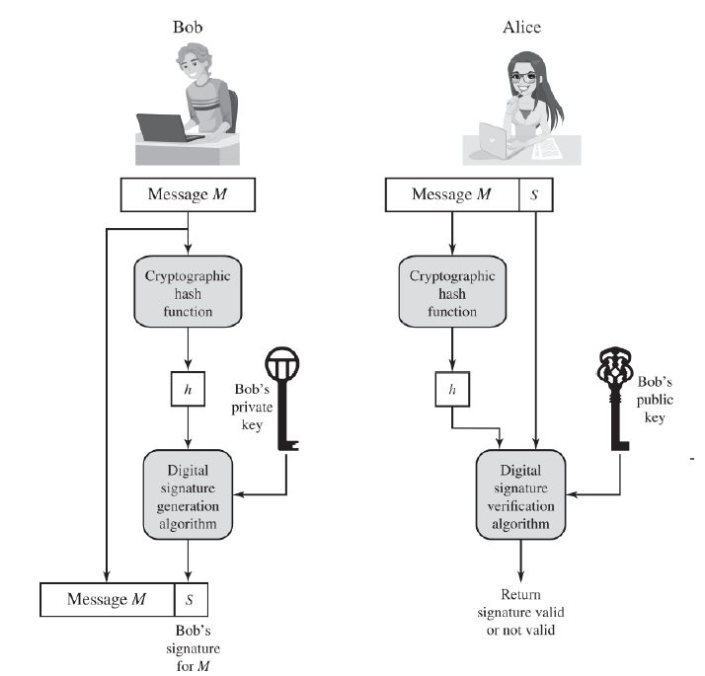
Digital Sig. Flowchart
Provides Integrity
Provides Non-Repudiation
Does not provide Confidentiality

Slide 14
Certificates
The key distribution problem.
How do people get your public key in the first place to test your signature?
You could broadcast them, but how do you know the broadcasts are authentic if they can’t be signed?
(Sub-optimal) Solution: Trusted Third Parties
Trustful
Centralized
Sounds like a mission for Blockchain, not sure if anyone has done this.
Certificates already cost money, why not some NFT? Web3?
Seeing some articles from 2018 that ask the same thing.
https://medium.com/@shayang/disrupting-blockchain-security-can-a-decentralized-certificate-authority-improve-trust-in-1d7af5d7fb2
Maybe a good ACM talk for next semester if someone is interested in looking into it.

Slide 15
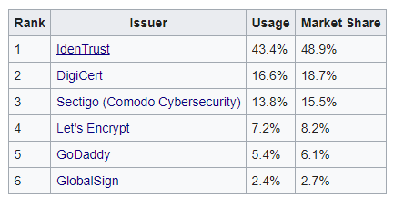
Certificate Authorities
Verisign -> 2010 -> Symantec -> 2017 -> Digicert

Slide 16
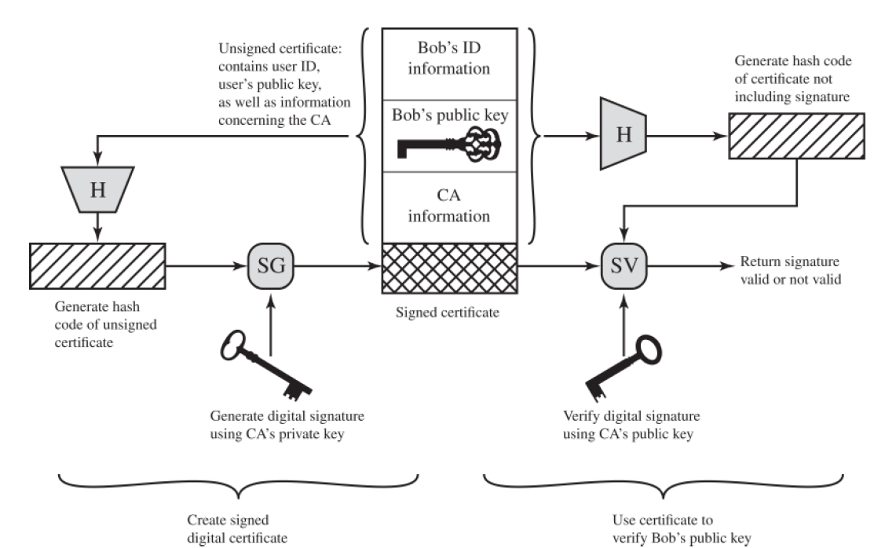
Certificate Process
How do you get CA public keys?
Often built into browsers
What if their key leaks?
CA Subversion

Slide 17
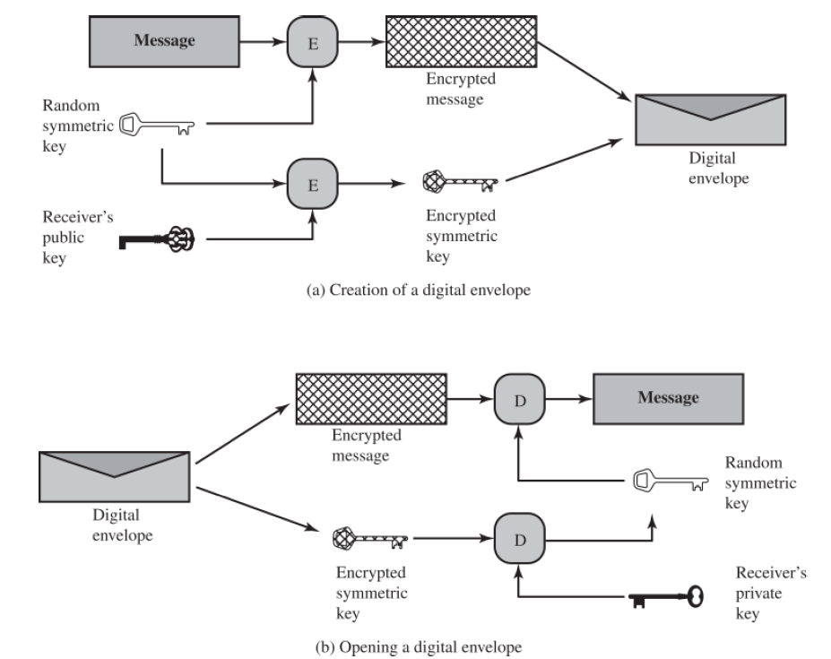
Digital Envelopes
Why not just encrypt the entire message with the public key?
Symmetric decryption probably faster.

